Slide 1

TOPIC: Steel Defect Detection
BY Krish Ambre

Slide 2
Overview of the problem
Steel is one of the most important building materials of modern times. Steel buildings are resistant to natural and man-made wear which has made the material ubiquitous around the world. To help make production of steel more efficient, this competition will help identify defects.
Severstal is leading the charge in efficient steel mining and production. They believe the future of metallurgy requires development across the economic, ecological, and social aspects of the industry—and they take corporate responsibility seriously. The company recently created the country’s largest industrial data lake, with petabytes of data that were previously discarded. Severstal is now looking to machine learning to improve automation, increase efficiency, and maintain high quality in their production.
In this challenge Severstal gave images of steel having defects. There are 4 classes of steel defects where an image can belong to more than one class.

Slide 3

Source of data
Fig 1 , retrieved from Severstal
https://www.severstal.com/

Slide 4
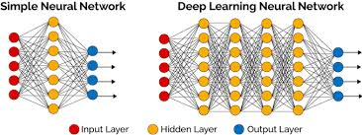
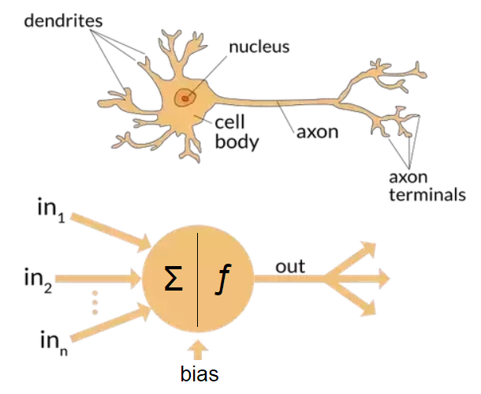
What is a Deep Neural Network (DNN)?
Artificial Neural Network
Biological Neural Network
Fig 2, retrieved from International Journal of Innovations in Engineering and Science, Vol. 4, No.6, 2019
Fig 3, retrieved from https://www.quora.com/What-is-the-differences-between-artificial-neural-network-computer-science-and-biological-neural-network
A Deep Neural Network is just an Artificial Neural Network with more than one hidden layers.

Slide 5
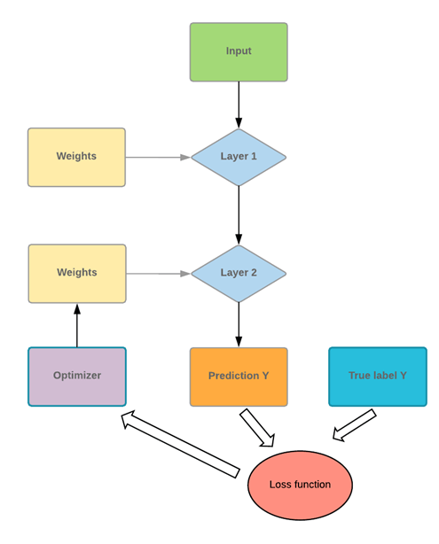

Algorithm!!!
Each layer has a number of nodes where the node gives outputs as –
Y = $b+\sum_{i=1}^{N}{mi}xi$ .
Y = b + W^{T} X in matrix notation
Fig 4, retrieved from https://www.guru99.com/artificial-neural-network-tutorial.html

Slide 6
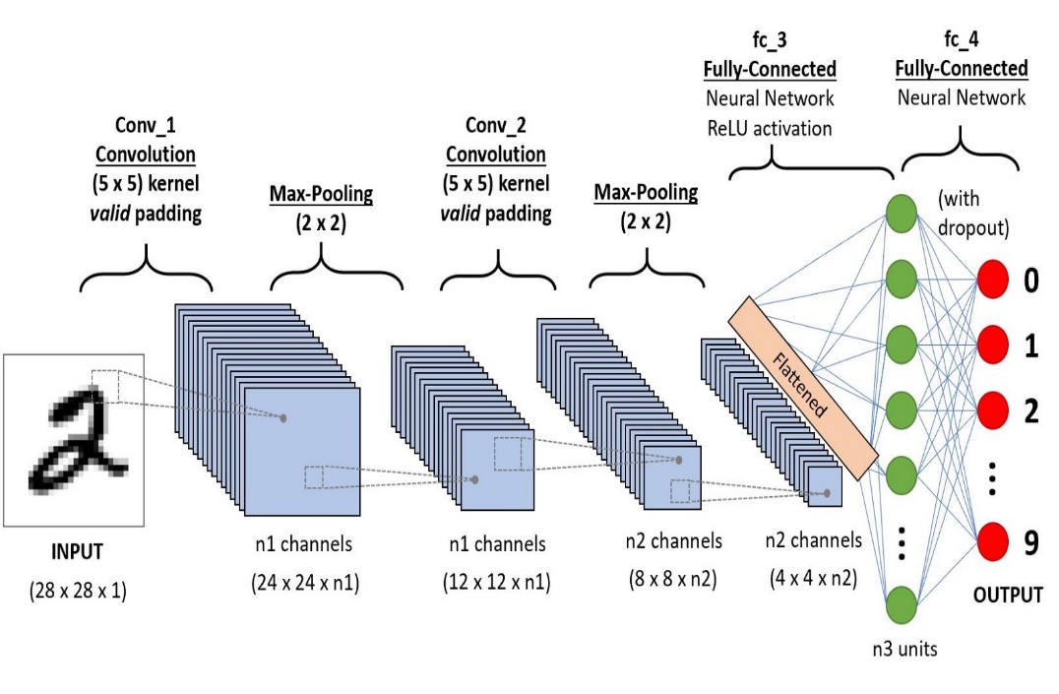
Convolutional Neural Network (CNN)
In Convolutional Neural Network we use Convolutional Layers instead of single entry nodes.
Convolution Operation :
Overlap the weight matrix and multiply the overlapped entries and take summation to get the number
Fig 5, retrieved from https://towardsdatascience.com/a-comprehensive-guide-to-convolutional-neural-networks-the-eli5-way-3bd2b1164a53

Slide 7
TerminoLogies IN Convolutional Neural Network (CNN)
CHANNELS: Colour channels like R,G, B, alpha ,IR
KERNEL: Corresponding to each channel we have a matrix of size of the input image which is called the kernel.
FILTER: A filter is a stack of kernels.
For a RGB image the filter would be a stack of 3 kernels.

Slide 8
MORE TerminoLogies IN Convolutional Neural Network (CNN)
PADDING: Padding image with 0 pixels so that the output size of the image after applying the convolution equals the desired output size
STRIDE: Step size of convolution operation.
Animation – Stanford

Slide 9
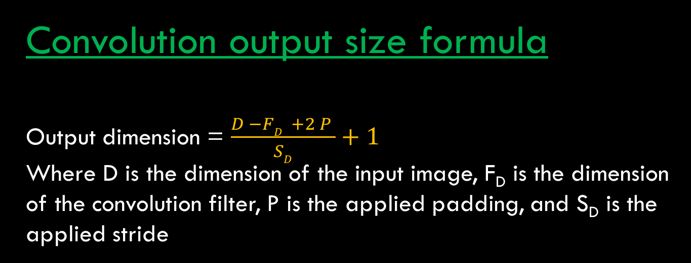
Convolution output size formula
Output dimension = $\frac{D −FD +2 P }{SD}+1$
Where D is the dimension of the input image, F_{D} is the dimension of the convolution filter, P is the applied padding, and S_{D} is the applied stride

Slide 10
Pooling Layers
Pooling : TO Reduce the size of input
Two Types of Pooling Layer Widely Used:
Max Pooling : the maximum pixel of the Image that overlaps with the filter is chosen
Average Pooling : Average value of The pixels in The be overlapped region between the filter and the image

Slide 11

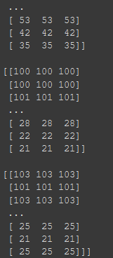
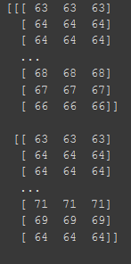
An Image from the Dataset
Source: Severstal Dataset
CORRESPONDING TENSOR OF PIXEL VALUES AS INTERPRETED BY THE COMPUTER
Shape of matrix
(256, 1600, 3)

Slide 12

Convolutional Neural Network
We are aware of the fact that the composition of primary colours Red, Blue, Green can form the complete spectrum of colours. For the computer a similar understanding is there. Every normal image is described as a $N×M×3$ tensor.
In a Convolutional Neural Network the nodes are not simply Y = $b+\sum_{i=1}^{N}{mi}xi$ but here there is a convolution operation taking place
Y = $b+filter∗image (a vector of some pixels)$
where filter is defined randomly with numbers and * is the convolution operation.

Slide 13


Resources USED
Coding Language : PYTHON
Packages of Python Used :
Matplotlib
Pandas
Tensorflow 2

Slide 14

Data Exploration
The data contains 6666 images of steel having defects classified into four classes 1, 2, 3, 4. Going from 1 to 4 the severity of the defect increases.
Each image is a 256 X 1600 X 3 matrix.

Slide 16
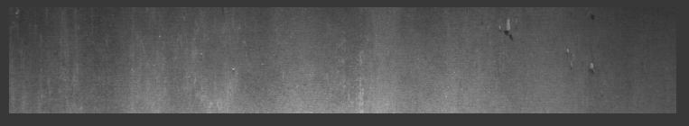
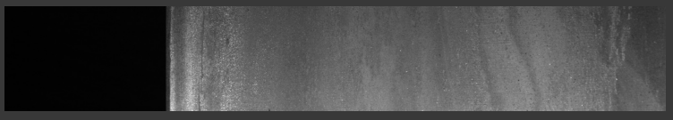
Defects Classification
Class 1 Defect
Source: Severstal Dataset
Class 2 Defect
Source: Severstal Dataset

Slide 17
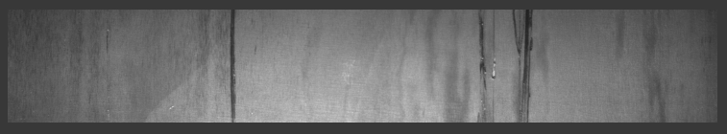
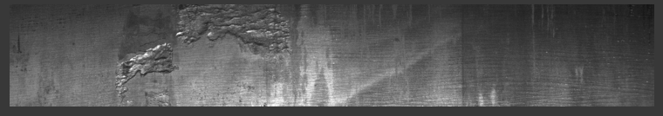
Class 3 Defect
Source: Severstal Dataset
Class 4 Defect
Source: Severstal Dataset

Slide 18
About the MODEL
Hyperparameters:
Validation SPLIT : 25%
LOSS Function : Categorical Cross Entropy
Optimizer : Adam with learning rate 0.001

Slide 19
WE USED TRANSFER LEARNING What is TRANSFER LEARNING?
USING A PRETRAINED MODEL WHICH IS ALREADY TRAINED ON A LARGE AMOUNT OF DATA. THE FEATURES OF THE NEW DATA MATCH THE OLD DATA.

Slide 20

ADVANTAGES OF TRANFER LEARNING
It involves the transfer of knowledge that is grasped in one source task to learn and refine the related target task.
These first layers features are found to be general features for many datasets.
Using transfer learning saves training time, resources, and SOLVES the problem of small data availability TO AN EXTEND.

Slide 21
Data AUGMENTATION TECHNIQUES
Helps to increase number of data samples by performing rotational, translational and other image transformations.
We used the KERAS input pipelines to load the images with ImageDataGenerator
The following transformations were used to generate the augmented data:
.
Rescale=1./255
Horizontal flip
Shear Range=0.1
Rotation range=360
Brightness range =(0.5, 1)
Vertical flip
Image Resized To= (299, 299,3)

Slide 22
BASE Model ARCHITECTURES USED
XCEPTION NET
Inception Resnet V2

Slide 23
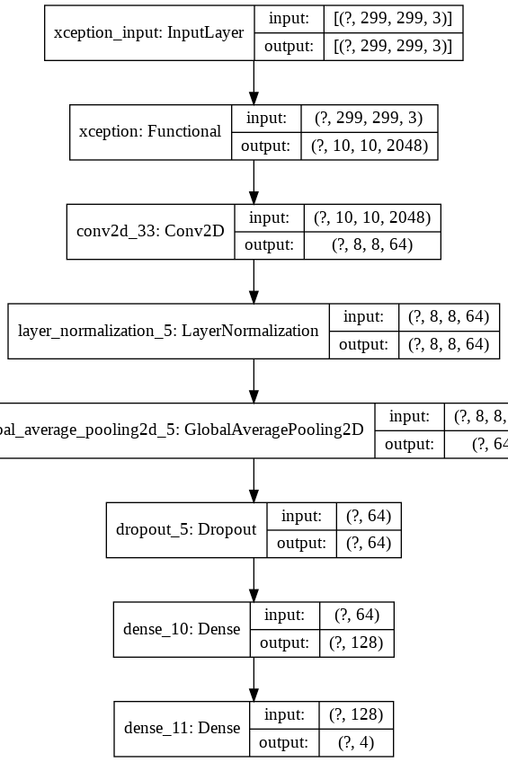
XCEPTION RETRAINED

Slide 24
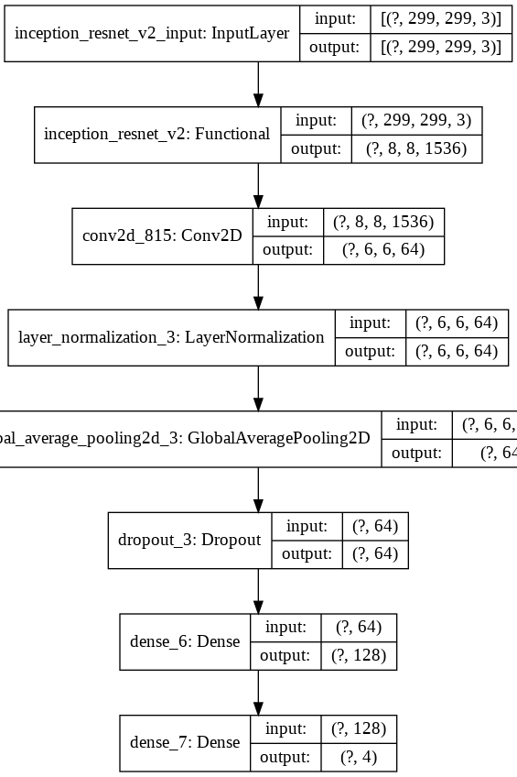
INCEPTION RESNET V2 RETRAINED

Slide 25
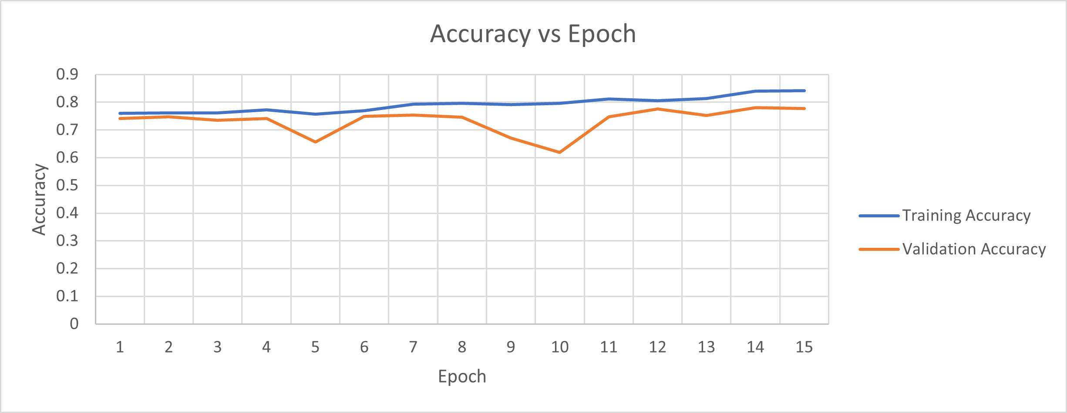
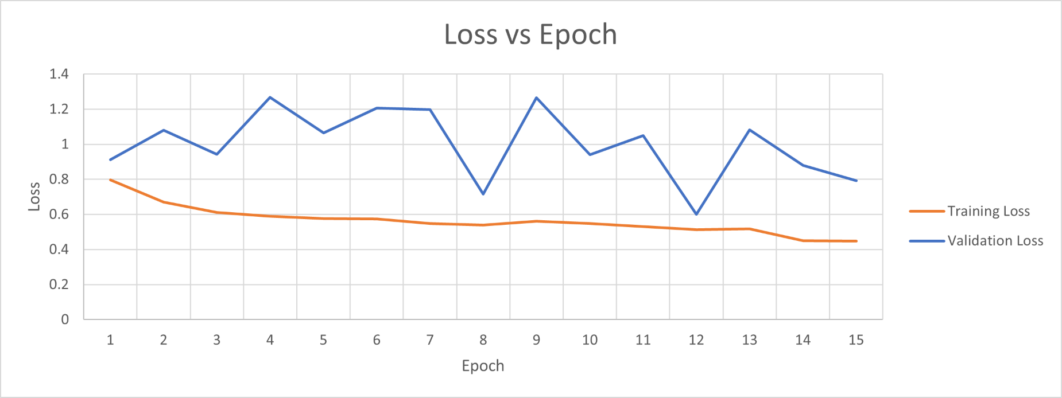
XCEPTION MODEL

Slide 26
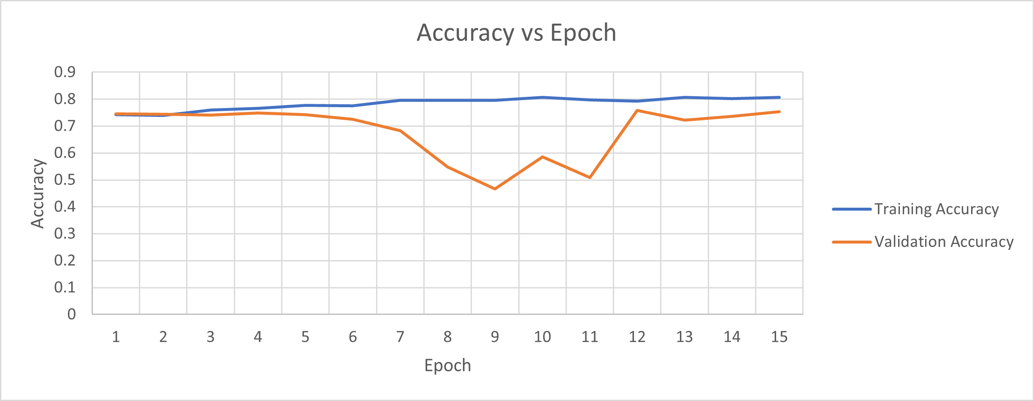
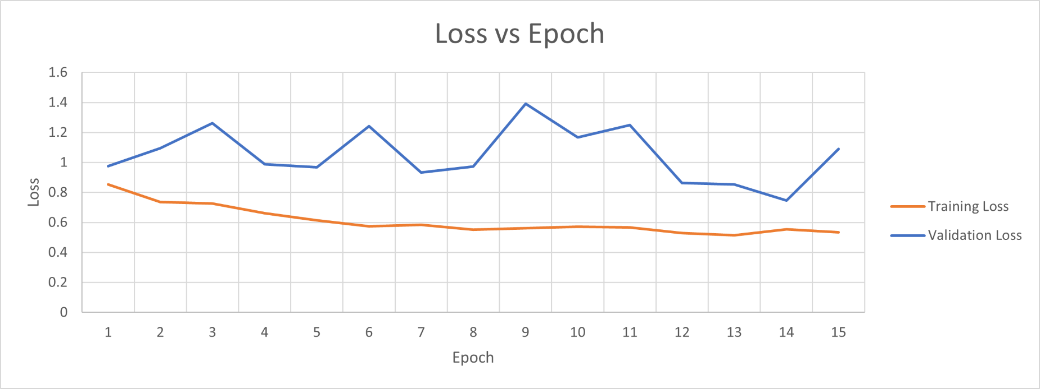
INCEPTION MODEL

Slide 27
The XCEPTION MODEL gave better Accuracy BOTH ON training and validation DATA than the inception Resnet V2
XCEPTION NET Training Set : 84% Validation Set: 77%
INCEPTION NET Training Set : 80% Validation Set: 75%

Slide 28
Why Xception Model is better Than inception model?
Depthwise Separable Convolution

Slide 29
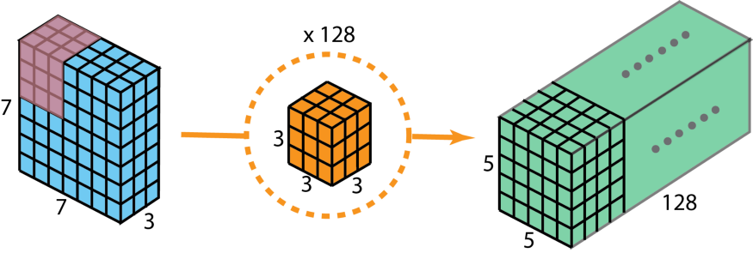
Normal Convolution
Fig 6, retrieved from https://towardsdatascience.com/a-comprehensive-introduction-to-different-types-of-convolutions-in-deep-learning-669281e58215
Each (3 X 3) kernel of the filter applies to one channel of the image and gives out a (5 X 5) kernel. By one filter we get 3 , (5 X 5) kernels
which are summed elementwise to get a filter of (5, 5, 1)
from (5, 5, 3). We have 128 such filters.
To get from one representation of data to the other we need here 3 X 3 X 3 X 128 = 3456 learned parameters.

Slide 30
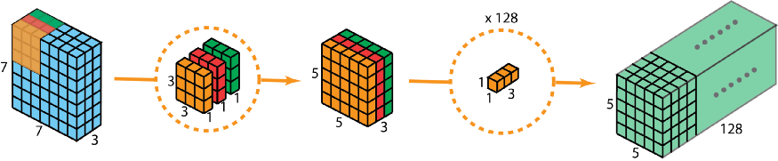
Depthwise Separable Convolution
Fig 7, retrieved from https://towardsdatascience.com/a-comprehensive-introduction-to-different-types-of-convolutions-in-deep-learning-669281e58215
Each (3 X 3) kernel of the filter applies to one channel of the image and gives out a (5 X 5) kernel. By one filter we get 3 , (5 X 5) kernels
which are summed elementwise to get a filter of (5, 5, 1)
from (5, 5, 3). Then we convolve the (5, 5, 3) filter with 1-D depth wise filters.
To get from one representation of data to the other we need here 3 X 3 X 3 + 1 X 1 X 3 X 128= 411 learned parameters.
Due to this reduction in number of parameters these models can be trained better and much deeper than the usual convolution 2-D layers.

Slide 31
References
https://www.kaggle.com/c/severstal-steel-defect-detection/overview
https://www.mdpi.com/2075-4701/10/6/846/htm
https://www.tensorflow.org/tutorials/images/cnn
https://towardsdatascience.com/types-of-convolution-kernels-simplified-f040cb307c37
https://cs231n.github.io/neural-networks-3/
https://towardsdatascience.com/intuitively-understanding-convolutions-for-deep-learning-1f6f42faee1

Slide 32
Useful LINKS to LEARN MORE
Padding and Strides
Convolution on RGB Image
https://keras.io/api/losses/

